Slide 1
Scalar Network Analyzer
How it Works
Dave VE3OOI

Slide 2
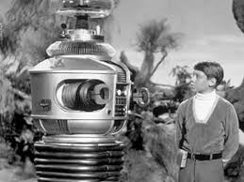
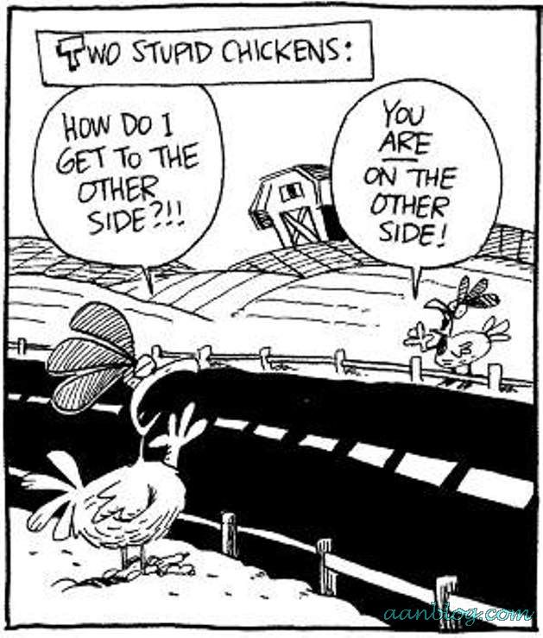
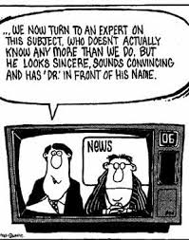
Danger will Robinson...

Slide 3
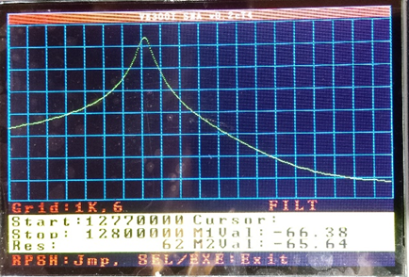
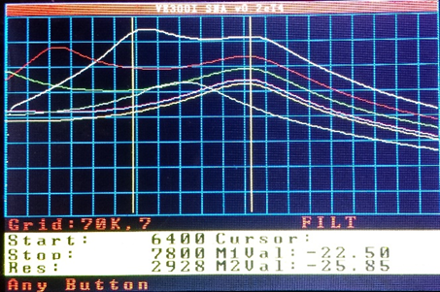
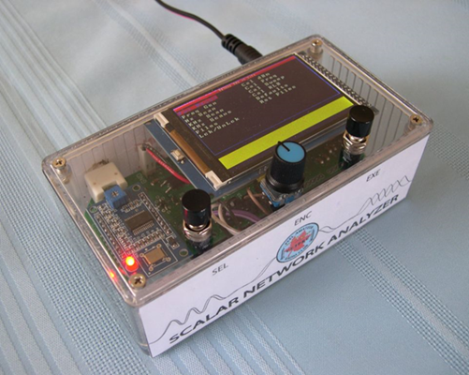
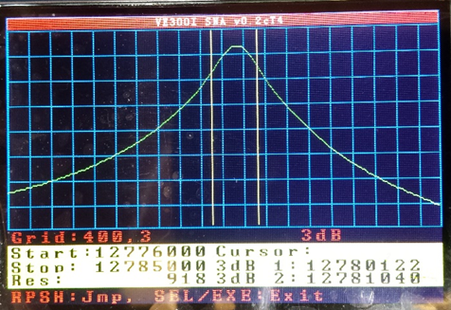
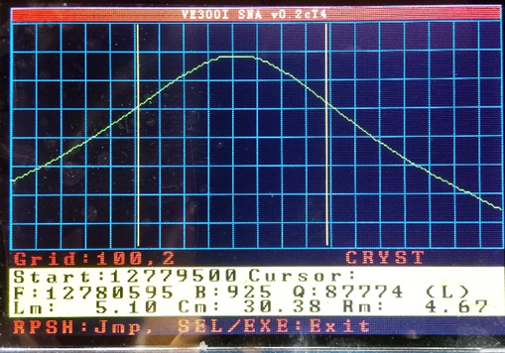
what this is.
A Basic Introduction
HOW DOES IT DO THIS?

Slide 4
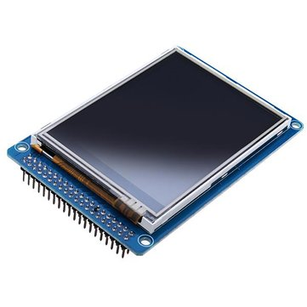
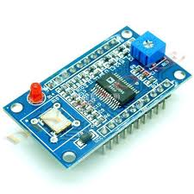
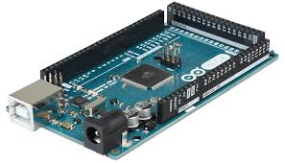
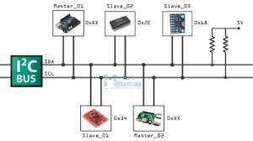

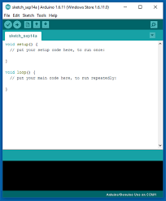
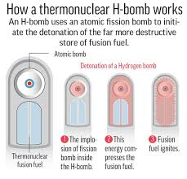
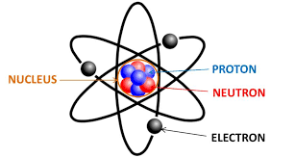
What this is not!

Slide 5
conceptual design
Generator
DUT
Detector
Compare Input(s) Signal to Output Signal
Inputs: Frequency, Amplitude
Output: Amplitude

Slide 6
Frequency dependent analysis
Sorta
Trying to understand the dependency on frequency.
i.e. How does the signal behave as a function of frequency
Examples:
Is this cable any good? Does the cable behave differently with frequency?
How well does this QRP amplifier work? What frequency do I get peak performance?
Is my Low Pass Filter working as expected within the band of interest?
Is my antenna tuned properly?
etc...

Slide 7

NON-Frequency dependent analysis
We have a low power detector...lets measure signals
i.e. How strong is this signal?
Examples:
How strong is the signal from this VFO, DDS, PLL oscillator?
How strong is the signal from this amplifier?
What is the SNR for this amplifier? (it may be possible)
etc...

Slide 8
Frequency injection
We have a frequency generator...let use it as a signal source
i.e. inject a signal of known frequency and amplitude into something
Examples:
Signal source to experiment with
A quick and dirty oscillator
Feed signal to a Mixer to modulate it.

Slide 9
GENERATOR
Issues:
Wrong Impedance (not 50R)
Impedance varies with frequency
Signal Amplitude varies with frequency
Signal Quality Deteriorates above 30ish MHz
AD9851 Module:
AD9851 is a DDS Oscillator
Uses a 30 MHz Crystal with 6x Multiplier (180 MHz)
Advertised: 0-70MHz
“After the 20-30MHz frequency harmonics increases, the waveform will be less and less clean”
AD9851 DDS
RF
Programmable Microcontroller

Slide 10

GENERATOR
Still Have a problem with roll off of signal amplitude with frequency.
Compensate in software (Huh?...wait for it)
AD9851 DDS
20 dB Pad
(Sets 50R)
60 MHz LPF
(50 R)
20dB LNA
(50R)
RF
Microcontroller:
Turns on the DDS
Sets the output frequency
Programmable Microcontroller

Slide 11
DETECTOR
Power Supply
Arduino Digital Noise
Other Noise
RF Noise
AD8307 :
Very Sensitive Detector (Logarithmic amplifier)
Measure RF signals down to -70 or -80 dBm (Strong RF signal – e.g. S9)
Outputs a DC voltage proportional to power of signal (i.e. dBm)
Sensitive to power supply noise
Sensitive to RF noise on traces
AD8307
RF
Noise
Programmable Microcontroller
DC Voltage

Slide 12

DETECTOR
Power Supply
8V Regulator
5V Regulator
2 KHz LRC LPF
Shield
AD8307
Isolated Ground Plane
Microcontroller:
Digitizes Output from AD8307
Performs Crude DSP on Data Based on Sweep Type
4 KHz RC LPF
Programmable Microcontroller

Slide 13

the story so far...
What's Wrong Here?
The Detector knows the signal strength from the DUT. So the SNA know this. Check!
How does the SNA know how strong the signal is from the Generator?
Generator
DUT
Detector
DC Voltage Proportional to Signal Power (Amplitude)
Configures 9850 Module to output a frequency.
The SNA has no idea what the signal strength from the Generator is
Programmable Microcontroller

Slide 14
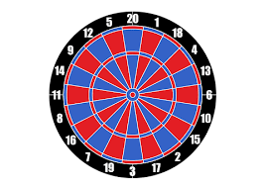
DUT: Return loss Bridge
RLB
From Generator
Microcontroller:
Sweeps through a set of frequencies
Reads voltage from 8307 which is the reflected signal from the bridge
Calculates Return Loss, SWR and Impedance
Reflected Signal to Detector
(Large Reflection)
Ant Not Connected
RLB
From Generator
Perfect Ant
Connected
Reflected Signal to Detector
(Small Reflection)
Generator
Return Loss Bridge
Detector
With no antenna connected “green” hole closed and every thing (black spots) bounces off.
Low Return Loss.
High Insertion Loss.
With a perfect antenna “green” hole is huge and every thing goes through and nothing bounces off.
High Return Loss
Low Insertion Loss
Programmable Microcontroller

Slide 15

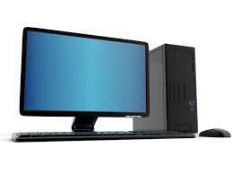

all together now
Generator
DUT
Detector
Microcontroller:
Controlled via LCD and push buttons
Save and recall data from sweeps to memory
Can be controlled via PC
Can export data to PC (e.g. for Excel)
Programmable Microcontroller
CLI
Memory

Slide 16
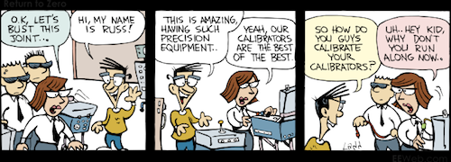
OK....NOW What?
Calibration:
The AD8307 output a voltage that we need to convert to dBm so we much teach the SNA about dBm (i.e. feed in known dBm values)
The AD9851 uses a crystal with may be slightly off frequency spec
i.e. 29.9998 MHz instead of 30 Mhz.
Need to apply a correction to compensate for actual crystal frequency.
We don’t measure the signal strength of the AD9851 and cannot do any meaningful comparisons
We need to understand how the signal strength from the AD9851 varies with frequency

Slide 17
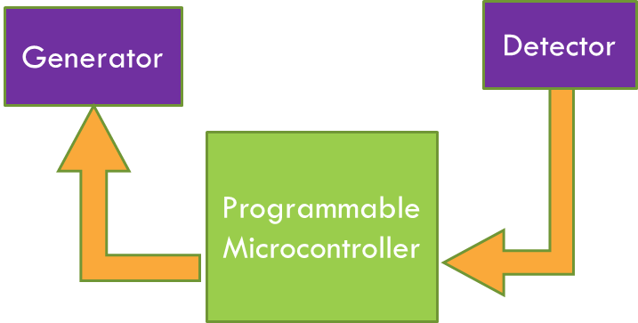
AD8307 Calibration
Train the SNA to understand the AD8307
Feed in two signal levels for comparison
SNA compares the AD8307 output voltage to the signal level
Formulates how to convert voltage to signal level
Slope = 42.51,
Intercept = -94.43

Slide 18
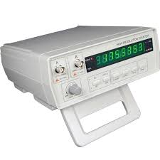
AD9851 Frequency accuracy calibration
Train the SNA to compensate for actual AD9851 Module crystal frequency.
Read the frequency from the SNA with a frequency counter
Change compensation factor until desired frequency is present

Slide 19
SWEEP CALIBRATION: Characterize output from Ad9851 module
Train the SNA to understand how the AD9851 output varies with frequency.
Connect the AD9851 module directly to AD8307
Change the frequency across entire supported frequencies (1 to 33 MHz)
Store the values in memory for lookup
Frequency | Signal Voltage | dBm
1000 KHz | 2.010 | -9.0
1070 KHz | 2.010 | -9.0
1140 KHz | 2.008 | -9.1
1210 KHz | 2.008 | -9.1
1280 KHz | 2.006 | -9.2
1350 KHz | 2.006 | -9.2
1420 KHz | 2.006 | -9.2
1490 KHz | 2.004 | -9.2
1560 KHz | 2.004 | -9.2
Create a lookup table from
1 MHz to 33 MHz and store it in memory

Slide 20
sweep resolution and The LCD
Banner
................................................................................................................................................................................................................................................................................. .................................................................................................................................................................................................................................................................................
.................................................................................................................................................................................................................................................................................
.................................................................................................................................................................................................................................................................................
...........................................................................................
There is a plot area were the sweeps are displayed.
The area is a fixed vertical and horizontal size
The LCD is made up of dots called pixels. Each pixel can be on, off and a colour
The LCD we use has 480 horizontal dots and 320 vertical does
The plot area has 478 horizontal dots and 220 vertical dots
To make plotting easy, we only take 478 readings – one for each dot.
Plot Area: 478 horizontal dots and 220 vertical dots
Plot and Menu Area
Data and Messages

Slide 21
data acquisition
Microcontroller:
User specifies start and end frequency
Calculates frequency increment based on max 478 frequencies
E.g. From 1 MHz to 2 MHz,
increment is 1MHz/478=2092 Hz
SNA calls this the resolution
Changes frequency by the resolution and read the output voltage from the AD8307.
The ADC values is store in memory and converted to dBm using AD8307 Calibration
DUT
Frequency | ADC Value | 8307 Voltage | Signal dBm
1000000 | 205 | 1.0 | -51.9
1002092 | 225 | 1.1 | -47.7
1004184 | 307 | 1.5 | -30.7
1006276 | 410 | 2.0 | -9.4
1008368 | 410 | 2.0 | -9.4
1010460 | 369 | 1.8 | -17.9
1012552 | 307 | 1.5 | -30.7
1014644 | 184 | 0.9 | -56.2
Table has 478 Values

Slide 22

a few closing thoughts...
Shred the furniture or his favorite shirt
The SNR is low...use a LNA?
A NORMAL CAT
DAVE’S CAT

Slide 23

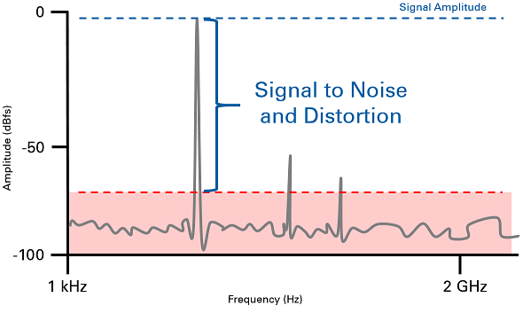
how low can you go?
What is the minimum SNR that allows the AD8307 to detect a signal accurately?
Datasheet: The AD8307 has very high gain and a bandwidth from dc to over 1 GHz, at which frequency the gain of the main path is still over 60 dB. Consequently, it is susceptible to all signals within this very broad frequency range that find their way to the input terminal

Slide 24
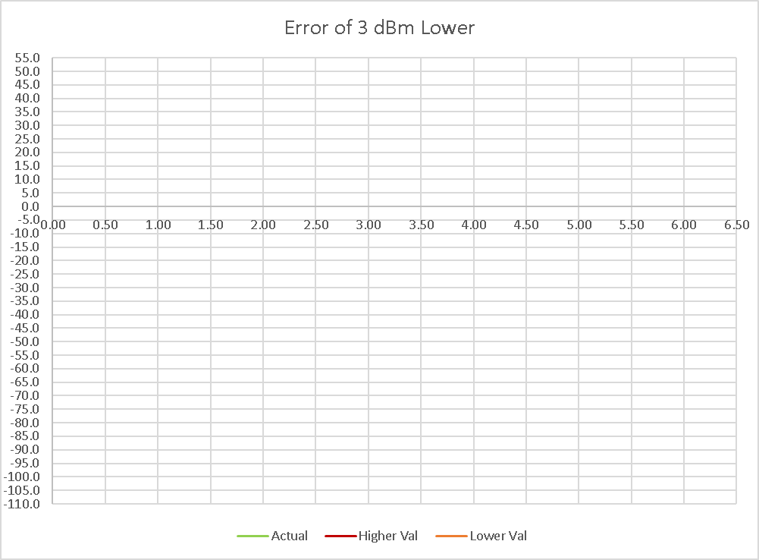
calibration errors
Green line is the actual calibration line with no error
Red Line the Higher Calibration Value is lower by 3 dB
-3 dBm instead of 0 dBm
Orange Line the Lower Calibration Value is lower by 3 dB
-36 dBm instead of -33 dBm
At +10 dBm error is about 3 dBm
At -70 dBm error is about 5 dBm
If both calibration values are off, then the error is worst.
Slope and Intercept: Used to calculate dBm at any voltage

Slide 25
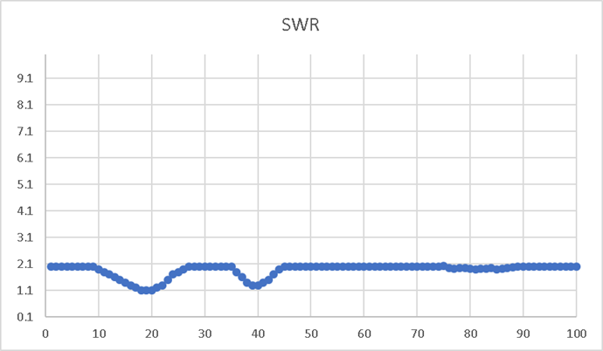
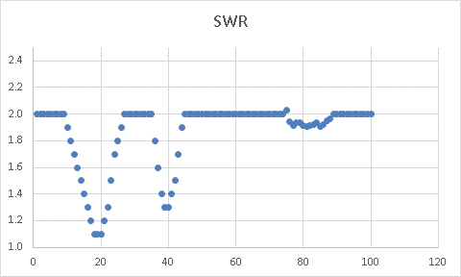
scaling
No Scaling performed horizontally. Each of the 478 data point plotted
Vertical plot scaled to get maximum view.
Vertical scaling magnifies any noise/jaggedness

Slide 26
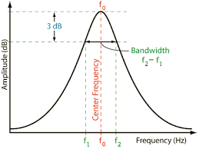
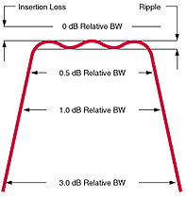
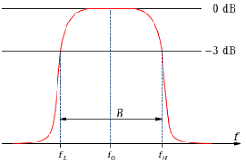
Crystal and 3db sweeps
The 3dB sweep is used to calculate crystal motional parameter using the crystal test fixture.
It calculates the peak (i.e. largest dB) and then looks for -3dB points to calculate the -3dB bandwidth.
If there is any ripple in the crystal bandpass, the 3dB sweep will generate erroneous results.
The curve must be “well behaved”
If the curve is flat this is ok
Probably do to response of crystal
i.e. sweep resolution is too small

Slide 27
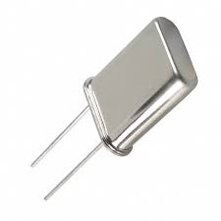
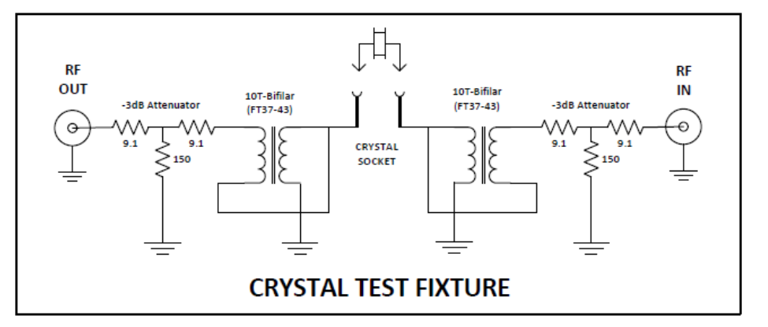
crystal calibration: the “Peter” perturbation
50R PAD
2:1 Transformer
2:1 Transformer
50R PAD
Forces
50R
Forces
50R
Transforms 50R to 12.5R
Use two -3dB pad totalling -6dB insertion loss
By default SNA adds back 6dB to 3dB sweep to calculate real insertion loss
More accurate is sweep the test fixture with crystal shorted out to measure “actual” extra insertion loss resulting from attenuator pads and transformer losses.
Hard code the result into SNA
Detailed in Advance Guide

Slide 28
